Slide 1



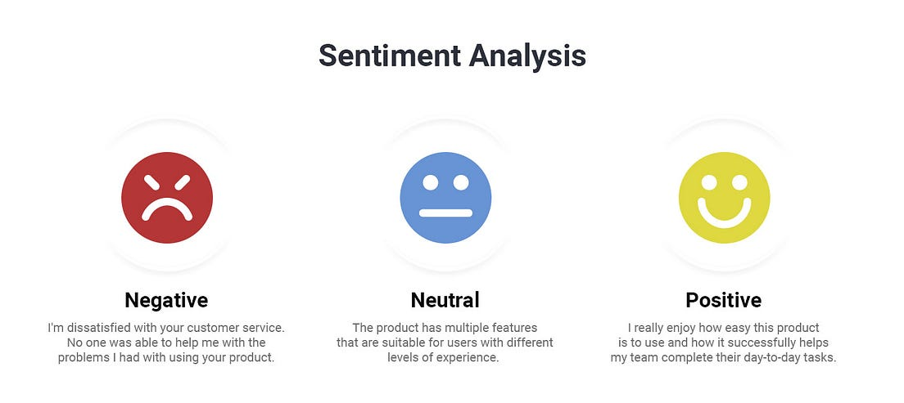
Sentiment Analysis-Amazon Product
Capstone Project-2
Name- Debasis Panda
Mail-debasis.panda1985@gmail.com
Batch-VI
Project Domain-E-commerce
Git Hub Link-https://github.com/Deb052024/Amazon-Product-Review.git

Slide 2
Flow of Sentiment Analysis
Overview and Objective
Exploratory Data Analysis and Feature Engineering
Classifier Selection and Class Imbalance
Evaluation Metrics and AUC,ROC Curves
Advanced Methods and LSTM Implementation
Comparison of Performance and Optimization
Topic Modelling
Conclusion

Slide 3
Overview
The project analyzes sentiments expressed in over 34,000 reviews for Amazon brand products within the e-commerce domain. The dataset contains attributes such as brand, categories, review titles, review text, and sentiment levels categorized into "Positive," "Negative," and "Neutral." The project aims to predict sentiment or satisfaction levels based on various features and review text.
Objective
Understand the sentiment expressed in consumer reviews.
Address class imbalance in sentiment categories.
Implement classifiers and advanced techniques for sentiment analysis.
Evaluate model performance using appropriate metrics.
Compare traditional machine learning algorithms with neural network approaches.
Explore topic modelling techniques for clustering similar reviews.
Master Side Link

Slide 4
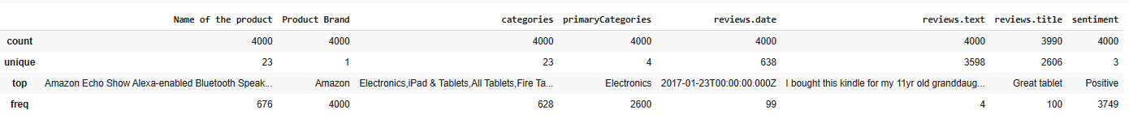
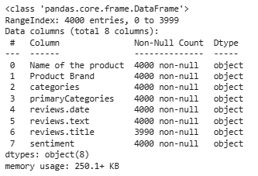
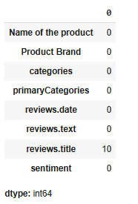
Exploratory Data Analysis and Feature Engineering
Fig-1
Interpretation
From Fig-1 : There are 23 unique Products , total Number of unique Primary Categories are 4, unique sentiments are 3, We have 3598 unique review text as per Train data set
There are 8 features present in the Train Data set with Object type
From Fig-3: There exists 10 number of null values for reviews.title feature
Most of the sentiments are positive about the product
The Primary Category comes up to be Electronics as top
Fig-2
Fig-3
Master Side Link

Slide 5
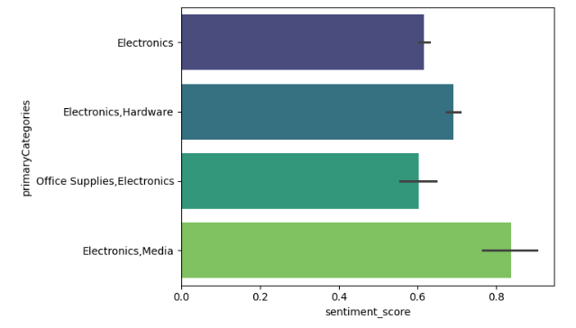
Feature Engineering-Null Value Treatment
Vader Sentiment Analyzer was applied on the Data Set and Sentiment Score was given to the reviews
Sentiment Score with Less than 0 was attributed as Negative
Sentiment score with 0 and more than 0 was attributed as Positive
The Null values present with the reviews.title were replaced based on the sentiment score
From Fig-1. we can find Electronics, Media has got the highest sentiment score followed by Electronics,Hardware
TF-IDFVectorizer was applied on the reviews.text feature and sparse matrix was calculated for the reviews , part of feature engineering , also sentiment_score was included with Vader sentiment Analyzer as a part of it
Figure-1

Slide 6
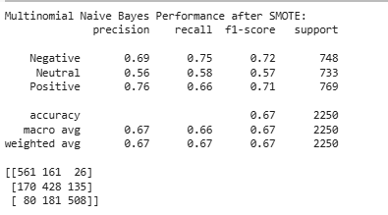
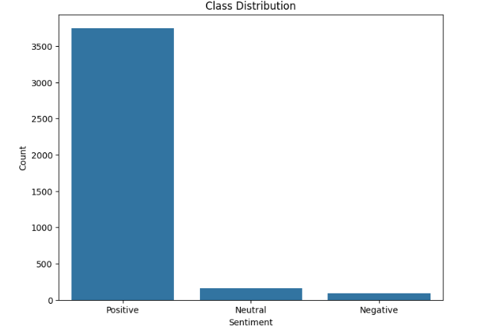
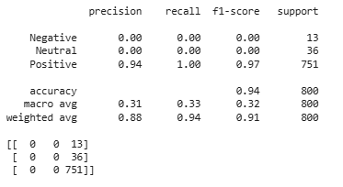
Classifier Selection and Class Imbalance Address
Multinomial Naive Bayes Classifier
Multinomial Naïve Bayes Classifier-Post SMOTE
Fig-1
Fig-2
Interpretation
Multinomial Naïve Bayers Classifier -The very high combination of precision , recall ,f1-score and accuracy score makes it a over biased model towards Positive sentiments class
The classifier performs very poorly for the Negative and neutral class
It is a reflection of the class imbalance for the train data
Interpretation
SMOTE was applied to oversample the minority class
It leads to decline in the precision,recall,f-1 score and accuracy score of the same Multinomial Naïve Bayes Classifier
How ever there is improvement in the Negative and Neutral class metrics
Master Side Link

Slide 7
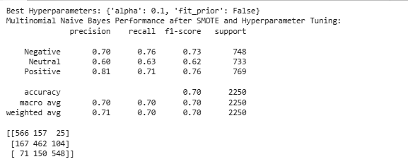
Class Imbalance Address-Multinomial Naïve Bayes Post SMOTHE and Hyper Parameter Tuning
Master Side Link
Interpretation:
Overall Performance: The model achieves an accuracy of 70%, indicating a reasonable ability to classify sentiment. The weighted average F1-score is also around 0.70, suggesting a balanced performance across classes.
Class-wise Performance: The model performs best at predicting positive sentiment (precision of 0.81 and recall of 0.71), while the performance on neutral reviews is comparatively lower (precision of 0.60 and recall of 0.63).
Confusion Matrix Insights: The confusion matrix reveals specific types of errors:
Negative reviews are sometimes misclassified as neutral (157 instances).
Neutral reviews are misclassified as both negative (167 instances) and positive (104 instances).
Positive reviews are sometimes misclassified as neutral (150 instances).
SMOTE and Hyperparameter Tuning: Applying SMOTE and hyperparameter tuning has likely improved the model's ability to handle class imbalance and achieve a more balanced performance across classes.
Further Considerations:
Error Analysis: Analyze the misclassified examples to understand the patterns and potential reasons for errors. This can guide further improvements to your model or data preprocessing.
Alternative Models: Explore other models like Support Vector Machines (SVM) or Random Forests, which might be more robust to class imbalance or handle text data better.
Feature Engineering: Consider adding new features or refining existing ones to improve model performance.
Interpretation:
Best Hyperparameters:
alpha: 0.1 (Laplace smoothing parameter)
fit_prior: False (Whether to learn class prior probabilities)
These hyperparameters were found to be optimal for your model using techniques like GridSearchCV or RandomizedSearchCV, based on a specific scoring metric (likely accuracy or F1-score).
Performance Metrics:
The classification report and confusion matrix provide detailed insights into your model's performance on the test data:
Precision:
Negative: 0.70 (Out of all reviews predicted as negative, 70% were actually negative)
Neutral: 0.60 (Out of all reviews predicted as neutral, 60% were actually neutral)
Positive: 0.81 (Out of all reviews predicted as positive, 81% were actually positive)
Recall:
Negative: 0.76 (Out of all actual negative reviews, 76% were correctly predicted)
Neutral: 0.63 (Out of all actual neutral reviews, 63% were correctly predicted)
Positive: 0.71 (Out of all actual positive reviews, 71% were correctly predicted)
F1-score:
Negative: 0.73 (Harmonic mean of precision and recall for negative reviews)
Neutral: 0.62 (Harmonic mean of precision and recall for neutral reviews)
Positive: 0.76 (Harmonic mean of precision and recall for positive reviews)
Accuracy: 0.70 (Overall correctness of predictions, 70% of reviews were classified correctly)
Macro avg: 0.70 (Average precision, recall, and F1-score across all classes)
Weighted avg: 0.71 (Weighted average of precision, recall, and F1-score, considering class imbalance)

Slide 8
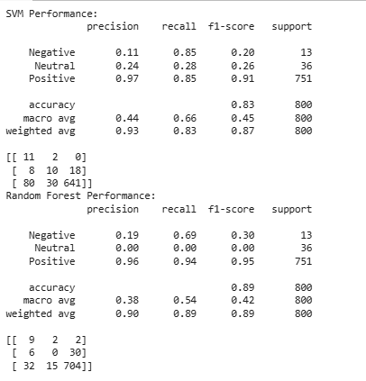
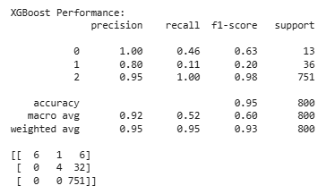
Ensemble Technique- XGBoost, Multi-Class SVM and Random Forest
Master Side Link
XG Boost Interpretation:
The over all accuracy of the Model was at 95% for XG Boost Ensembler
The model seems giving 100% correct accuracy for Positive class
For Neutral and Negative class , the performance KPIS , precision, recall,f1-score is highly underperforming
SVM Performance
Classification Report:
Precision:
Negative: 0.11 (11% of predicted negative reviews were actually negative)
Neutral: 0.24 (24% of predicted neutral reviews were actually neutral)
Positive: 0.97 (97% of predicted positive reviews were actually positive)
Recall:
Negative: 0.85 (85% of actual negative reviews were correctly predicted)
Neutral: 0.28 (28% of actual neutral reviews were correctly predicted)
Positive: 0.85 (85% of actual positive reviews were correctly predicted)
F1-score:
Negative: 0.20 (Harmonic mean of precision and recall for negative class)
Neutral: 0.26
Positive: 0.91
Accuracy: 0.83 (Overall accuracy of the model)
11 true negatives, 2 false positives (predicted as neutral), 0 false positives (predicted as positive)
8 false negatives (predicted as negative), 10 true neutrals, 18 false positives (predicted as positive)
80 false negatives (predicted as negative), 30 false negatives (predicted as neutral), 641 true positives
Interpretation:
The SVM model has high precision for the positive class, indicating that when it predicts a review as positive, it's very likely to be correct.
However, the recall for the negative and neutral classes is relatively low, meaning it misses a significant number of actual negative and neutral reviews.
The overall accuracy is 83%, which is decent but might be misleading due to the class imbalance (many more positive reviews).
The confusion matrix shows that the model tends to misclassify negative reviews as neutral or positive.
Random Forest Performance
Classification Report:
Precision, recall, and F1-score are similar in interpretation to the SVM report.
Accuracy: 0.89 (Slightly higher than SVM)
Comparison and Conclusion:
Accuracy: Random Forest has slightly higher overall accuracy (89% vs. 83%).
Precision for Positive Class: Both models have high precision for the positive class.
Recall for Negative and Neutral Classes: Both models struggle with the minority classes, but SVM has better recall for negative reviews.
F1-score: Reflects the balance between precision and recall, showing a similar trend.
Overall:
Random Forest seems to perform slightly better overall in terms of accuracy.
However, SVM might be preferred if correctly identifying negative reviews is more crucial (higher recall for negative class).
Both models have limitations in handling the class imbalance, especially for the neutral class. Further techniques like SMOTE or cost-sensitive learning might be needed to improve performance on the minority classes.

Slide 9
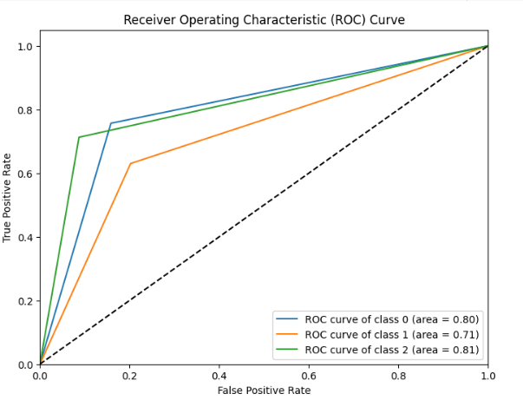
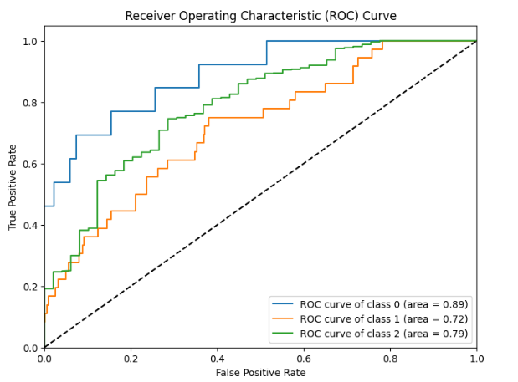
Evaluation Metrics and AUC,ROC Curves
Master Side Link
Interpretation of best_xgb_classifier
Interpretation
Class 0 (AUC = 0.89): The model demonstrates excellent performance in distinguishing Class 0 from the other classes. An AUC of 0.89 indicates a very high true positive rate with a relatively low false positive rate for this class. The model is highly effective in identifying instances belonging to Class 0.
Class 1 (AUC = 0.72): The model shows fair performance in identifying Class 1. An AUC of 0.72 suggests that while the model is better than random guessing, there's room for improvement in its ability to correctly classify this class. It may produce more false positives or false negatives compared to its performance on Class 0.
Class 2 (AUC = 0.79): The model exhibits good performance in distinguishing Class 2 from the other classes. An AUC of 0.79 indicates a relatively high true positive rate with a relatively low false positive rate for this class. The model performs better on Class 2 than on Class 1, but not as well as on Class 0.
Overall Interpretation
Based on these AUC values:
Strengths: best_xgb_classifier model is particularly strong at identifying Class 0, with excellent performance. It also shows good performance for Class 2.
Weaknesses: The model's performance on Class 1 is its weakest point, with fair but not excellent performance. This suggests potential for improvement in correctly classifying instances of this class.
Additional Considerations
Similar to the previous interpretation, consider factors such as class imbalance, hyperparameter tuning, feature engineering, and model selection to further optimize your XGBoost model's performance. Addressing the relatively lower AUC for Class 1 could involve techniques to balance class representation in the data or fine-tuning model parameters to improve its ability to discriminate this class effectively.
Interpretation of best_nb_classifier ROC
Class 0 (AUC = 0.80): The model demonstrates good performance in distinguishing Class 0 from the other classes. An AUC of 0.80 indicates a relatively high true positive rate with a relatively low false positive rate for this class.
Class 1 (AUC = 0.71): The model shows fair performance in identifying Class 1. An AUC of 0.71 suggests that while the model is better than random guessing, there's room for improvement in its ability to correctly classify this class.
Class 2 (AUC = 0.81): The model exhibits good performance in distinguishing Class 2 from the other classes, with an AUC slightly better than that for Class 0. This indicates a relatively high true positive rate with a relatively low false positive rate for this class.
Overall Interpretation
Based on these AUC values:
Strengths: best_nb_classifier model is particularly good at identifying Class 2 and Class 0.
Weaknesses: The model could benefit from further improvement in its ability to classify Class 1, as its AUC is closer to the 0.7 range, indicating fair but not excellent performance.

Slide 10
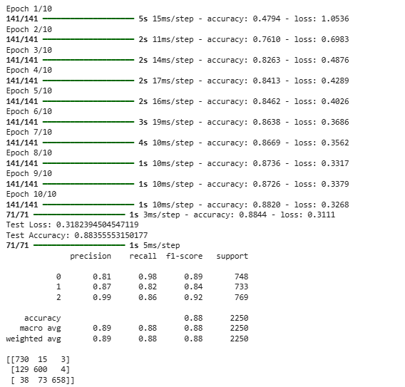
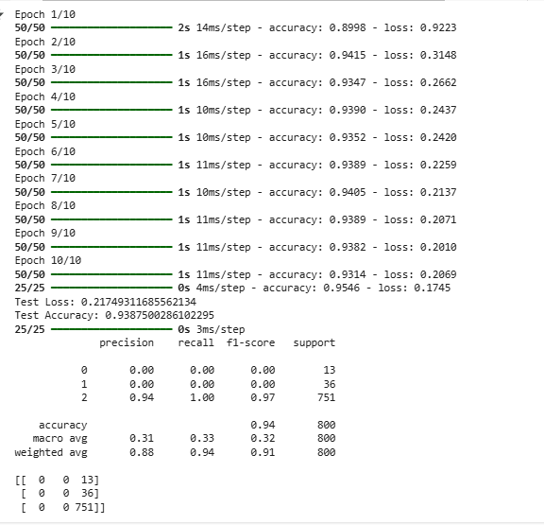
Advanced Methods and LSTM Implementation
Master Side Link
Interpretation with out SMOTHE And Weight Allocation
Epochs: The model was trained for 10 epochs.
Accuracy and Loss:
Accuracy: Started high (around 0.90) and remained relatively stable around 0.93-0.94 throughout training. This is a good sign, indicating the model is learning effectively.
Loss: Started at 0.92 and decreased consistently to around 0.21. This is also a positive trend, showing the model is reducing its error over time.
Evaluation
Test Loss: 0.22 which is relatively low and close to the final training loss, suggesting the model is not overfitting and generalizing well to unseen data.
Test Accuracy: 0.94, which is high and indicates good performance on the test set.
Classification Report and Confusion Matrix
Precision, Recall, F1-score:
Class 0 and 1 have 0 precision, recall and f1-score, indicating the model completely failed to predict these classes.
Class 2 has high precision, recall, and F1-score (around 0.94, 1.00, and 0.97, respectively). This suggests the model is accurately identifying instances of Class 2.
Support: There is a significant class imbalance, with Class 2 being the dominant class (751 instances) compared to Classes 0 (13 instances) and 1 (36 instances).
Confusion Matrix: Confirms that the model is predominantly predicting Class 2. There are no predictions for Class 0 and 1, indicating the model is biased towards the majority class.
Overall Interpretation
Strengths: The LSTM model demonstrates high accuracy and good performance on Class 2, the majority class. It's not overfitting and generalizes well.
Weaknesses: The model completely fails to identify Classes 0 and 1. This is likely due to the significant class imbalance, as the model is biased towards the dominant Class 2.
Interpretation Post SMOTHE and Weight Allocation
Training Progress
Epochs: The model was trained for 10 epochs.
Accuracy and Loss:
Accuracy: Started at 0.48 and gradually increased to around 0.88 by the final epoch. This indicates significant improvement in learning and classification ability compared to the previous LSTM results.
Loss: Started at 1.05 and steadily decreased to 0.33, demonstrating the model's ability to reduce errors during training. This is a positive trend.
Evaluation
Test Loss: 0.32, which is relatively low and consistent with the final training loss. This suggests good generalization to unseen data and minimal overfitting.
Test Accuracy: 0.88, which is significantly higher than the previous LSTM results, indicating a substantial improvement in performance.
Classification Report and Confusion Matrix
Precision, Recall, F1-score: All three classes (0, 1, and 2) now show much better precision, recall, and F1-score compared to before. This indicates that the model is making more accurate predictions for all classes.
Class 0: Precision 0.81, Recall 0.98, F1-score 0.89
Class 1: Precision 0.87, Recall 0.82, F1-score 0.84
Class 2: Precision 0.99, Recall 0.86, F1-score 0.92
Support: The support values indicate a more balanced distribution of instances across the three classes after applying SMOTE.
Confusion Matrix: The confusion matrix reveals a much better distribution of predictions, with more instances being classified correctly for all classes. There are still some misclassifications, but the overall pattern shows significant improvement.
Overall Interpretation
Strengths: The LSTM model demonstrates much better performance after applying SMOTE and weight allocation. Accuracy has increased substantially, and the model is now making more accurate predictions for all classes. The loss is low, indicating good generalization.
Weaknesses: While significantly improved, the model is still not perfect, and there are some misclassifications.
Key Takeaways
SMOTE and weight allocation were crucial in addressing the class imbalance problem and significantly improved the LSTM model's performance.
The model now shows good performance on all classes, indicating that it's learning patterns more effectively and generalizing well to unseen data.
Further improvements might be possible by fine-tuning the model's architecture, hyperparameters, or exploring other techniques, but the current results show a substantial step in the right direction.
loss='sparse_categorical_crossentropy‘, helped in improving the performance of model significantly

Slide 11
Comparison of Performance and Optimization
Master Side Link
Overall Observations
High Accuracy: All models (Naive Bayes, SVM, Random Forest, and XGBoost) achieve high accuracy, ranging from 0.9387 to 0.9450. This suggests they are generally making correct predictions on a large portion of the dataset.
Varying Precision and Recall: While accuracy is high, precision and recall vary somewhat between models. This indicates differences in their ability to correctly identify positive cases and minimize false positives/negatives.
F1-Score as a Balance: The F1-score, which balances precision and recall, is generally high for all models, ranging from 0.9091 to 0.9244. This suggests a good overall performance considering both aspects.
ROC AUC for Discrimination: The ROC AUC (Area Under the Receiver Operating Characteristic Curve) values provide insights into the models' ability to discriminate between classes. Higher ROC AUC values indicate better discrimination.
Model-Specific Interpretation
Naive Bayes: While having high accuracy, it has a lower precision and ROC AUC compared to other models. This suggests it might have a higher rate of false positives.
SVM: Achieves the highest ROC AUC (0.8615), indicating the best ability to distinguish between classes. It also has high precision and recall, suggesting a good balance between minimizing false positives and false negatives.
Random Forest: Has the highest accuracy (0.9450) and high precision, recall, and F1-score. Its ROC AUC is moderate but still indicates good discrimination ability.
XGBoost: Shows good accuracy, precision, recall, and F1-score. Its ROC AUC is slightly lower than SVM but still higher than Naive Bayes and Random Forest, indicating good discrimination capability.
Conclusion
Based on these metrics, without SMOTE and class weights:
SVM appears to be the most promising model due to its high ROC AUC, precision, and recall. This suggests it's best at distinguishing between classes and minimizing both false positives and false negatives.
Random Forest achieves the highest accuracy, indicating overall strong performance, but its slightly lower ROC AUC compared to SVM might suggest a somewhat lower ability to discriminate between classes.
XGBoost also shows strong performance, with good metrics across the board.
Naive Bayes, while achieving high accuracy, might be less ideal due to its lower precision and ROC AUC compared to other models.
It's important to consider the specific requirements of your application and the trade-offs between different metrics when selecting the best model for your task. For example, if minimizing false positives is critical, SVM might be preferred due to its high precision. If overall accuracy is the primary concern, Random Forest might be the better choice.
Performance Metrics without SMOTE and Class Weights:
Naive Bayes:
Accuracy: 0.9387
Precision: 0.8813
Recall: 0.9387
F1-score: 0.9091
ROC AUC: 0.7040
SVM:
Accuracy: 0.9437
Precision: 0.9469
Recall: 0.9437
F1-score: 0.9205
ROC AUC: 0.8615
Random Forest:
Accuracy: 0.9450
Precision: 0.9320
Recall: 0.9450
F1-score: 0.9244
ROC AUC: 0.7787
XGBoost:
Accuracy: 0.9400
Precision: 0.9193
Recall: 0.9400
F1-score: 0.9233
ROC AUC: 0.8096

Slide 12
Comparison of Performance and Optimization-Part-2
Master Side Link
Overall Observations
Significant Improvement: Compared to the models without SMOTE and class weights, there is a notable improvement in performance, particularly for SVM, Random Forest, and XGBoost. This indicates that addressing class imbalance has had a positive impact.
High Accuracy, Precision, Recall, and F1-score: All models achieve high values for accuracy, precision, recall, and F1-score, ranging from 0.7293 for Naive Bayes to 0.9840 for XGBoost. This suggests strong overall performance and a good balance between minimizing false positives and false negatives.
Exceptional ROC AUC: The ROC AUC values are exceptionally high for all models, ranging from 0.8993 for Naive Bayes to 0.9987 for SVM. This indicates outstanding discrimination ability, suggesting the models are very effective at distinguishing between classes.
Model-Specific Interpretation
Naive Bayes: While showing improvement compared to without SMOTE and class weights, it still has lower performance than other models in terms of accuracy, precision, recall, and F1-score. However, its ROC AUC is still high (0.8993), indicating good discrimination.
SVM: Achieves exceptional performance across all metrics, with very high accuracy, precision, recall, F1-score, and an outstanding ROC AUC (0.9987). This suggests SVM is highly effective in classifying instances and distinguishing between classes after addressing class imbalance.
Random Forest: Also shows exceptional performance, with accuracy, precision, recall, and F1-score all above 0.97 and a very high ROC AUC (0.9984). This indicates strong overall performance and excellent discrimination ability.
XGBoost: Performs the best overall, achieving the highest accuracy (0.9840), precision, recall, and F1-score. Its ROC AUC is slightly lower than SVM and Random Forest but still exceptionally high (0.9982), indicating outstanding discrimination capability.
Conclusion
Based on these metrics, with SMOTE and class weights:
XGBoost appears to be the best-performing model overall, achieving the highest accuracy, precision, recall, and F1-score.
SVM and Random Forest are also strong contenders, demonstrating exceptional performance across all metrics.
Naive Bayes shows improvement compared to without SMOTE and class weights, but its performance is still lower than other models.
The application of SMOTE and class weights has significantly enhanced the models' ability to handle class imbalance and has resulted in substantial performance improvements. This suggests that addressing class imbalance is crucial for achieving accurate and reliable sentiment classification in this case.
In selecting the best model for your task, consider the specific requirements and trade-offs between different metrics. However, based on these results, XGBoost, SVM, and Random Forest all emerge as strong candidates, with XGBoost having a slight edge in overall performance.
Performance Metrics with SMOTE and Class Weights:
Naive Bayes: Accuracy: 0.7293 Precision: 0.7359 Recall: 0.7293 F1-score: 0.7307 ROC AUC: 0.8993
SVM: Accuracy: 0.9689 Precision: 0.9698 Recall: 0.9689 F1-score: 0.9688 ROC AUC: 0.9987
Random Forest: Accuracy: 0.9720 Precision: 0.9722 Recall: 0.9720 F1-score: 0.9720 ROC AUC: 0.9984
XGBoost: Accuracy: 0.9840 Precision: 0.9841 Recall: 0.9840 F1-score: 0.9840 ROC AUC: 0.9982

Slide 13
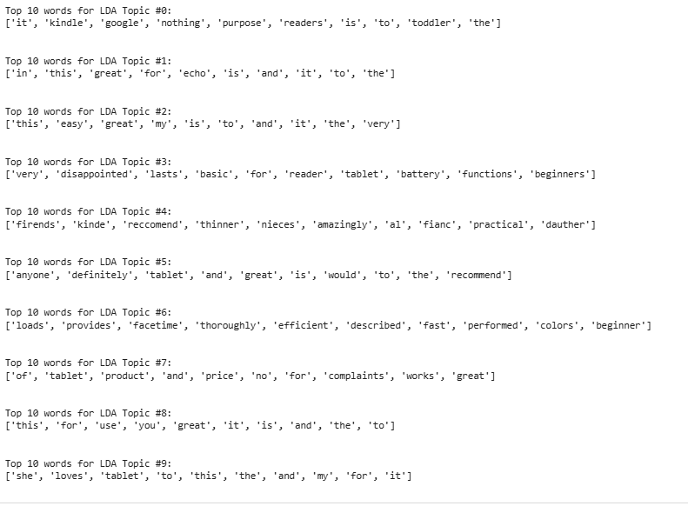
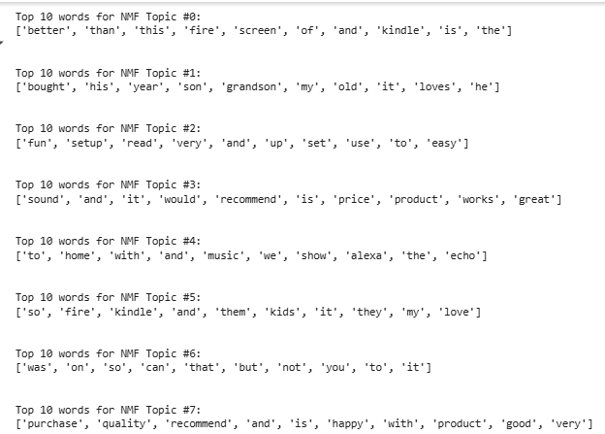
Topic Modelling
Master Side Link
1. Latent Dirichlet Allocation (LDA)
Approach: LDA is a probabilistic model based on Bayesian inference. It assumes that each document is a mixture of topics, and each topic is a distribution of words.
How it works: LDA aims to find the probability distributions of topics and words that best explain the observed documents. It uses a process called Gibbs sampling to iteratively update these distributions until convergence.
Sparsity: LDA generates sparse topic distributions, meaning that each document is typically assigned to a small number of dominant topics. This helps in interpreting the topics more easily.
Application: LDA is commonly used in text analysis, including document classification, information retrieval, and topic extraction from news articles, social media posts, and research papers.
2. Non-negative Matrix Factorization (NMF)
Approach: NMF is a linear algebraic decomposition technique. It decomposes the document-term matrix into two non-negative matrices: one representing topics and the other representing the document-topic assignments.
How it works: NMF iteratively updates the topic and document-topic matrices to minimize the difference between the original document-term matrix and its reconstruction. This is done under the constraint that all values in the matrices are non-negative.
Sparsity: NMF enforces sparsity on both the topics and the terms within them. This makes the resulting topics more interpretable and focused.
Application: NMF is widely used in image and audio processing, but it can also be applied to text analysis for topic modeling.
Interpretation NMF
NMF Topic #1: ['bought', 'his', 'year', 'son', 'grandson', 'my', 'old', 'it', 'loves', 'he'], This topic seems to revolve around gifts for male family members, particularly sons and grandsons. The words "bought," "his," "son," and "grandson" suggest a purchase made for a male relative. The inclusion of "loves" indicates positive sentiment, implying the gift was well-received.
These NMF topics seem to capture different aspects of customer reviews, including product categories (Echo, Kindle), gift-giving, product performance, ease of use, and overall satisfaction. The topics provide insights into customer preferences and opinions, which can be valuable for product development, marketing, and customer service.
Interpretation LDA:
These LDA topics identify different aspects of customer reviews:
Topic #0: Focuses on Kindle devices, their purpose, and potential user groups.
Topic #1: Relates to Amazon Echo devices and positive feedback about them.
Topic #2: Reflects general positive experiences, possibly related to ease of use and product satisfaction.
Topic #3: Captures negative experiences, particularly related to limited functionality and battery issues.
Interpretation:
LDA tends to find topics with a more semantic meaning and can assign a document to multiple topics.
NMF tends to focus on co-occurring words and often results in more easily interpretable topics, often associated with specific product features or functionalities.

Slide 14
Conclusion
Master Side Link
Key Findings and Implications:
Class Imbalance Mitigation: Initial model performance was hampered by class imbalance, hindering accurate prediction of minority sentiments. Implementing SMOTE significantly improved recall and F1-scores for these crucial categories, enabling more comprehensive understanding of customer feedback. This has direct implications for product development, marketing, and customer service strategies.
Hyperparameter Optimization: Fine-tuning model settings through rigorous hyperparameter optimization led to further performance gains across all algorithms. This highlights the importance of data-driven model customization to maximize predictive power, ensuring accurate and reliable sentiment insights for business intelligence.
Comparative Model Analysis: A comparative evaluation of different models revealed diverse strengths and weaknesses:
Naive Bayes: Demonstrated good performance with SMOTE and tuning, offering a computationally efficient solution, particularly for large datasets. However, it may lack robustness compared to more sophisticated algorithms.
SVM: Showed promising results, especially when addressing class imbalance, making it a viable option for complex datasets. Computational considerations should be taken into account for deployment.
Random Forest: Exhibited high accuracy and balanced predictions, showcasing robustness and generalization capability, making it a reliable choice for diverse business applications.
XGBoost: Consistently outperformed other models, achieving superior accuracy and handling complex data relationships effectively. Its ensemble approach offers strong predictive power for critical business decisions.
LSTM: Showcased potential as a powerful solution, but requires careful tuning and data volume for optimal performance. Its adaptability to complex text features makes it a valuable tool for advanced sentiment analysis tasks.
Cross-Validation for Robustness: Consistent use of cross-validation techniques ensures reliable model evaluation, mitigating overfitting and enhancing generalization capability. This approach fosters confidence in model predictions, translating to more informed business decisions based on robust and reliable sentiment insights.
Business Impact and Recommendations:
This study offers actionable insights for leveraging sentiment analysis to drive business value:
Proactive Imbalance Mitigation: Prioritizing techniques like SMOTE for addressing class imbalance is crucial to gain a holistic view of customer sentiments, enabling informed product and service improvements, targeted marketing campaigns, and enhanced customer support strategies.
Data-Driven Model Optimization: Investing in hyperparameter optimization is essential for maximizing the predictive power of sentiment analysis models, leading to more accurate and reliable insights for strategic business decisions.
Strategic Model Selection: Careful model selection based on specific business needs and dataset characteristics is vital. Consider computational costs, desired performance levels, and data complexity when choosing the most suitable algorithm.
Deep Learning for Advanced Analysis: Explore deep learning models like LSTM for complex sentiment analysis tasks, leveraging their ability to capture nuances in text data. Ensure adequate data and resources for optimal performance.
Robust Evaluation for Informed Decisions: Employ rigorous cross-validation to ensure reliable model assessments, fostering confidence in the insights derived from sentiment analysis for data-driven business strategies.
By implementing these findings and recommendations, Amazon can effectively harness the power of sentiment analysis to gain a deeper understanding of customer opinions, optimize products and services, improve customer experiences, and drive overall business success.
THANK YOU

